Slide 1
DEMAND AND SUPPLY OF OIL AND GAS
A brief view of unsatisfying demand and supply of OIL AND GAS since COVID - 19

Slide 2
Crude oil supply in 2014
Saudi Arabia 16%
Angola 13%
Russia 11%
Oman 10%
Iraq 9%
Iran 9%
Venezuela 4%
UAE 4%
Kuwait 3%
Colombia 3%
Congo 2%
Brazil 2%
South Sudan 2%
Kazakhstan 2%
Others 9%

Slide 3
The determined demanded value for gas depends on.
Gas demand
Weak dollar
US Production
Middle East
Summer

Slide 4
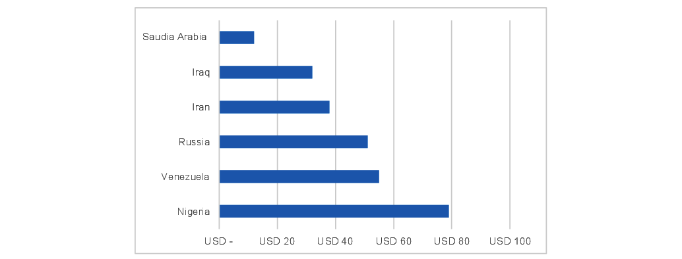
COVID EFFECTS ON OIL & GAS PRICES

Slide 5
Gas Demand And Supply
Gas Supply
Notes:
Column 3 : Total Supply (Indigenous and Imported)
Supply : Gas Supply
Demand : Total demand

Slide 6
World Crude Oil Supply and Demand (GRAPH)

Slide 7
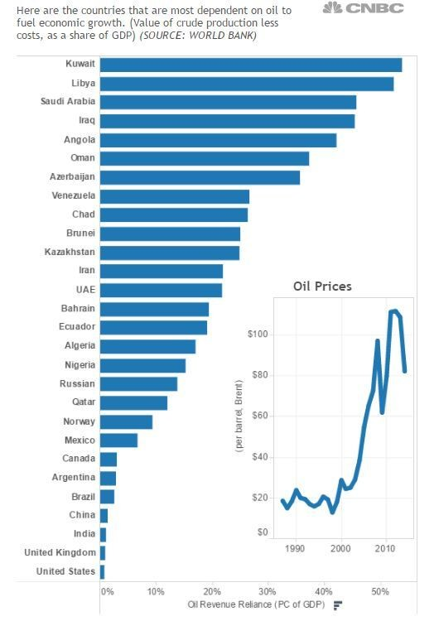
Economy Dependency Of Nations On Oil And Gas

Slide 8
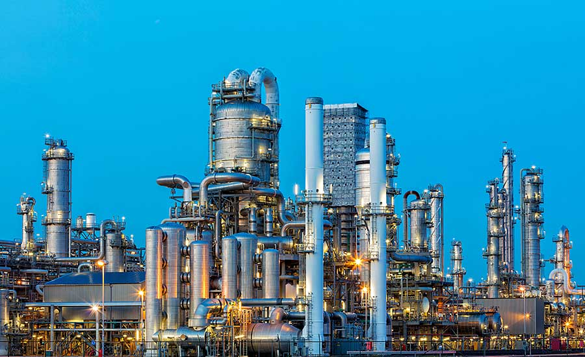
Stopped Production
Many countries stopped the production of oil and gas due to heavy losses

Slide 9
THANKYOU

